Slide 1
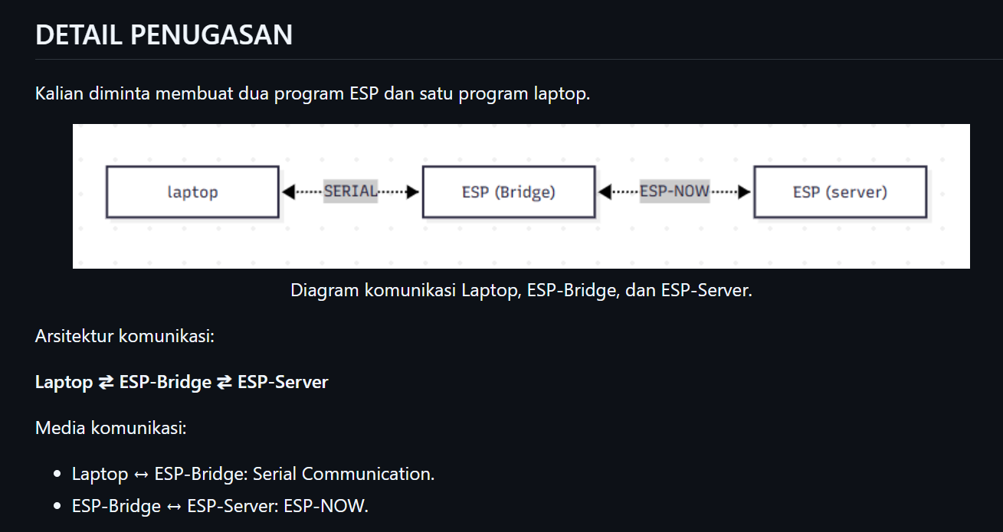

Slide 2
TODO 1 (LAPTOP)
INTERFACE
TODO 2 (ESP BRIDGE)
PENGHUBUNG LAPTOP AND ESP SERVER / TRANSLATOR
TODO 3 (ESP SERVER) –
PROSESNYA / MIKIRNYA

Slide 3
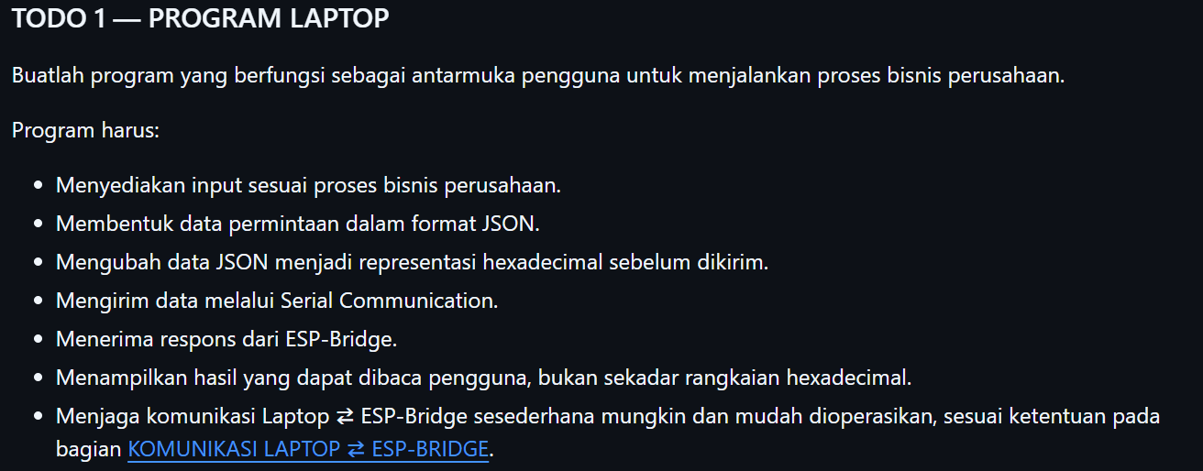
INTERFACE

Slide 4
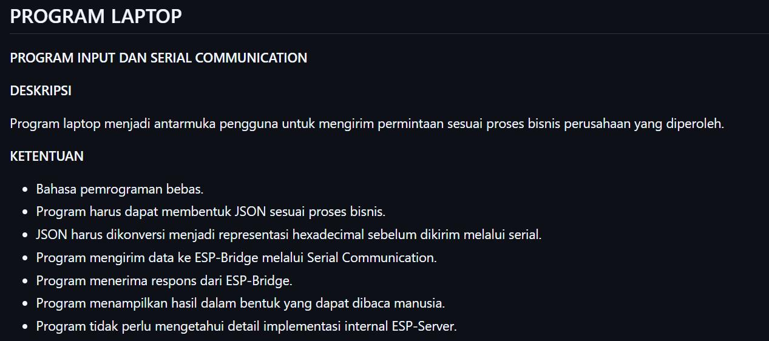
INTERFACE

Slide 5
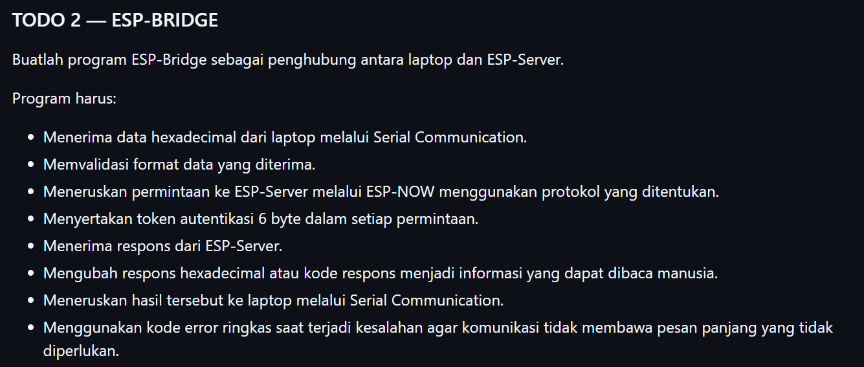
PENGHUBUNG LAPTOP AND ESP SERVER / TRANSLATOR

Slide 6
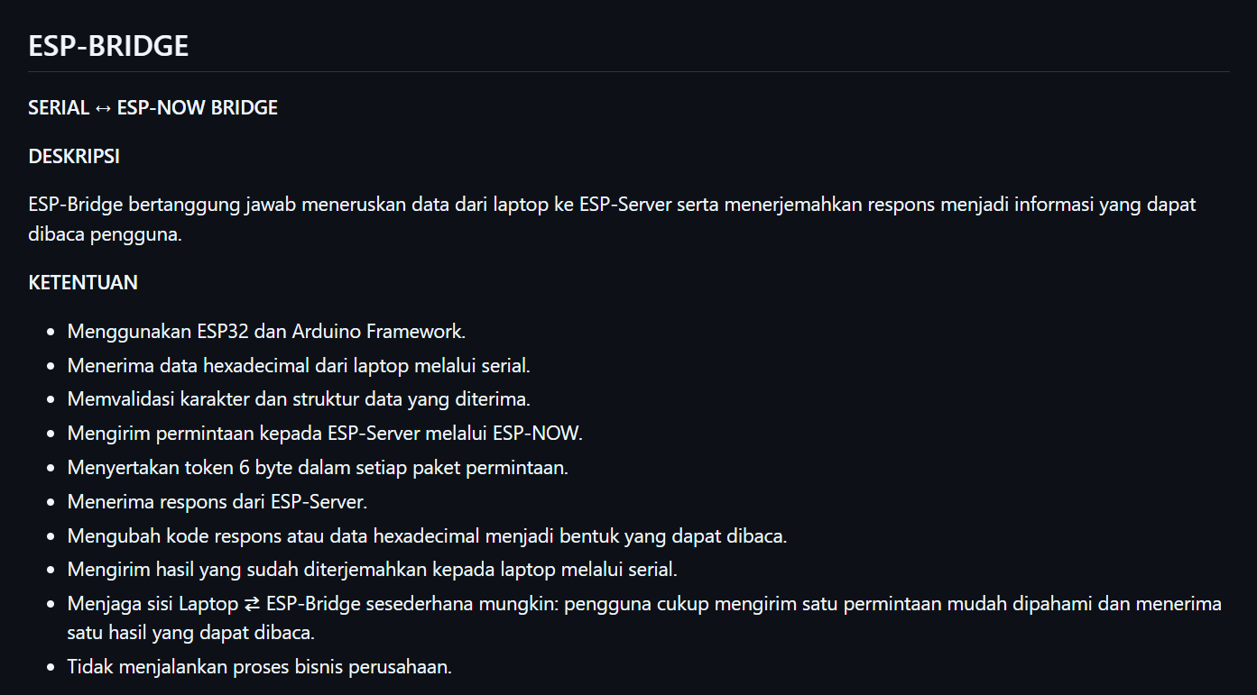
PENGHUBUNG LAPTOP AND ESP SERVER / TRANSLATOR

Slide 7
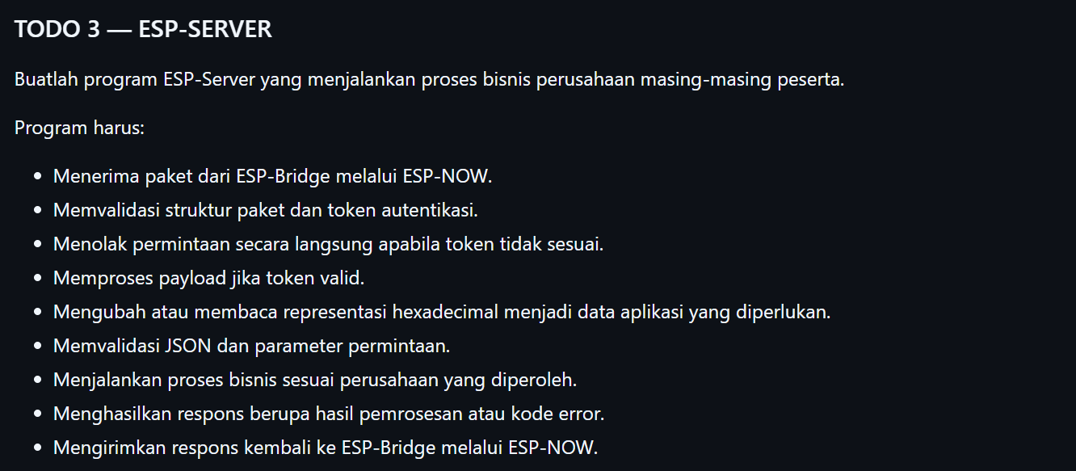
PROSESNYA / MIKIRNYA

Slide 8
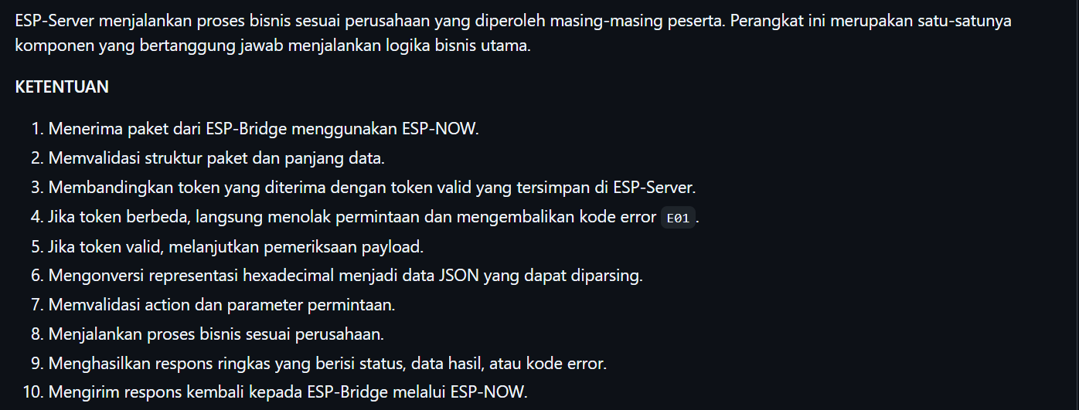
PROSESNYA / MIKIRNYA

Slide 9
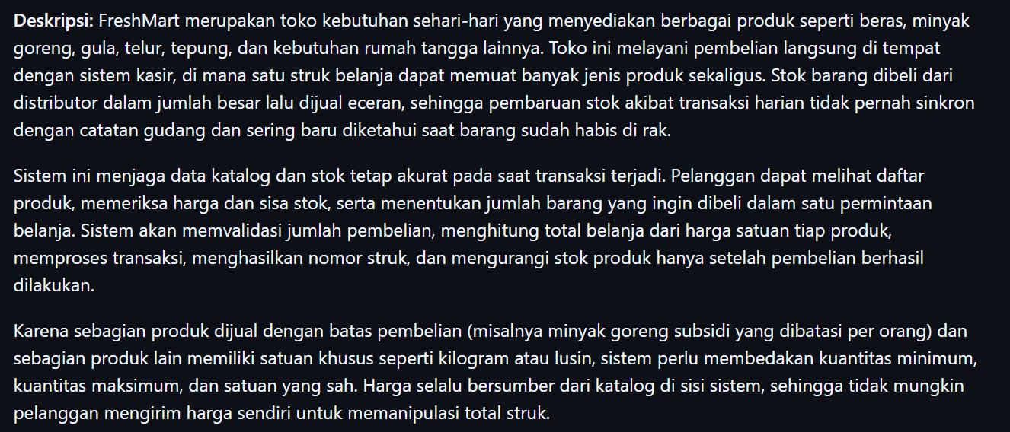
PERUSAHAAN

Slide 10
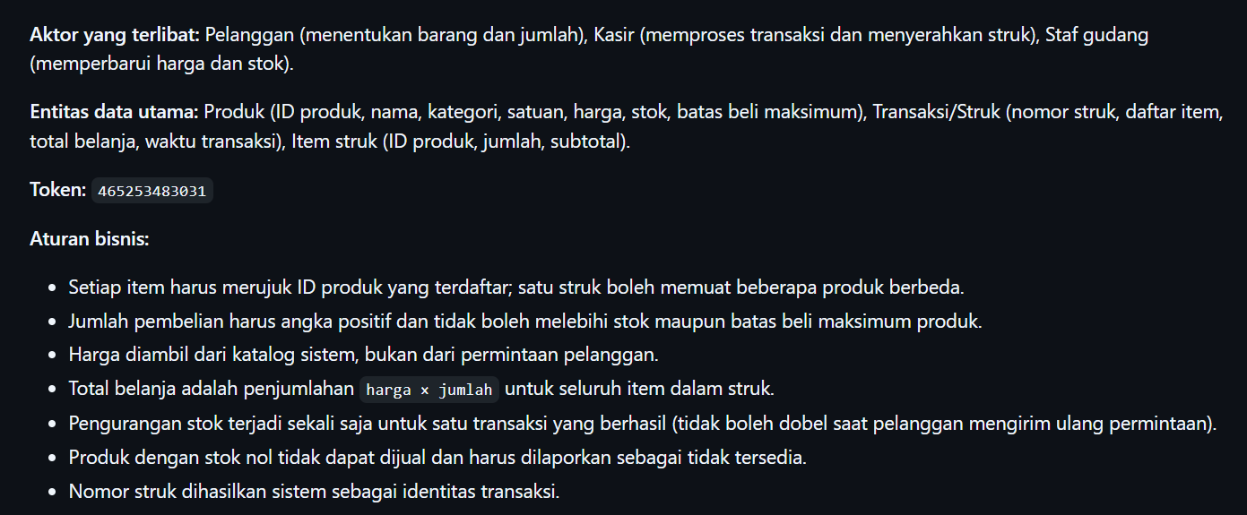
PROSESNYA

Slide 11
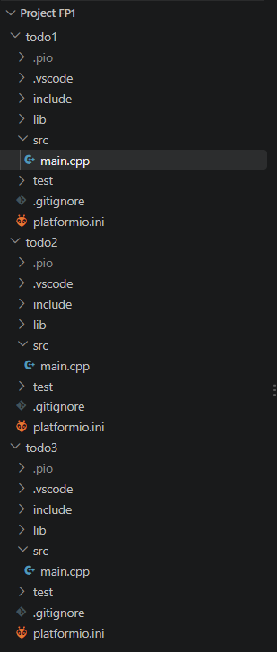
Project FP1
todo1
Src: main.cpp
todo2
Src: main.cpp
todo3
Src: main.cpp

Slide 12
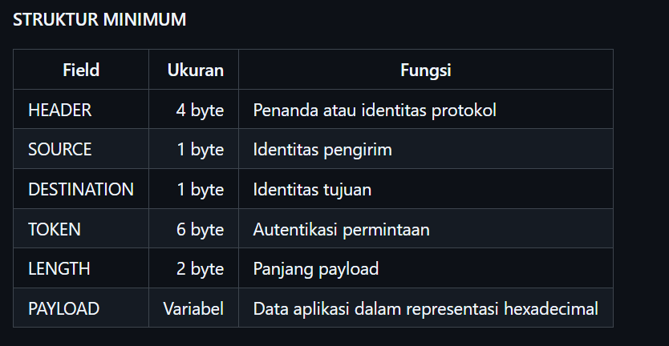
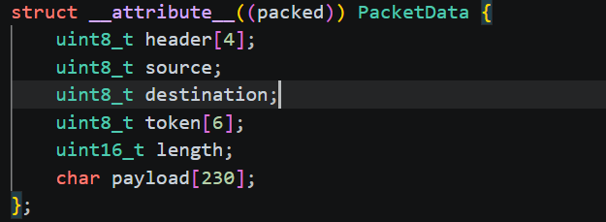

Slide 13
